Slide 1


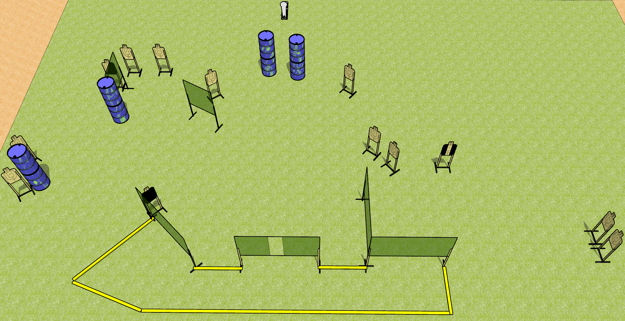
 | Dothan Gun Club – USPSA Match Scoot Scoot Scoot Course Designer : Drew Coleman
Round Count 27 rounds 13 USPSA 1 colt popper
Equipment List 3 medium fault lines 11 wall feet 1 headshot, 1 right diagonal HC, 1 tuxedo

Slide 2
Scoot Scoot Scoot
Written Stage Briefing
Scoot Scoot Scoot is a 27 round, 135 point, Comstock course of fire. There are 13 USPSA targets and 1 colt popper. The best 2 hits on paper will score, and steel must fall to score. The start signal is audible.
Handgun start position is both feet touching any fault line, wrists below belt. Handgun is loaded and holstered.
PCC start position is both feet touching any fault line, stock on belt. Loaded carbine is held with both hands, safety on.
On start signal, engage targets as they become available from within the shooting area.

